Slide 1
The Rewards and Challenges of Teaching Spanish Online: From Development to Delivery
Jennifer Rafferty, MA, M.Ed.
Associate Director of Instructional Design-QU Online
Part-time Spanish Instructor, School of Health Sciences, Quinnipiac University

Slide 2
Objectives
Describe one distance learning language model implemented at Quinnipiac University
Explore course design and instructional strategies
Examine learners’ perceptions of the course

Slide 3
Characteristics of the Model
Primarily asynchronous model
Textbook with DVD
Partner-based activities
Task-based approach
Multiple technologies
Synchronous mid-term on Skype
In person final exam
Summer (10 weeks) Spring (14 weeks)

Slide 4
Timeline
Needs Analysis School of Nursing
Summer 2009
Research - DL Pedagogy and Textbook Review
Fall 2009
Develop
Course
January –May 2010
Pilot- 6 faculty, 2 students
Summer 2010
14 students, 1 faculty
Spring 2011
8 Students
Summer 2011
18 students
Spring 2012

Slide 5
Best Practices-Online Course Design
Syllabus - explicit & descriptive, estimated time on tasks
Instructor welcome announcement
Course overview presentation
Modular format - thematic titles
Learning outcomes
Intentional, repetitive pattern in learning activities and course calendar
Backward course design
Rubrics
Instructor-student, content-student, student-student interaction
Learner support/technical support
Quality Matters Rubric Standards, 2008-2010 edition

Slide 6
Who is right for online learning?

Slide 7
Profile of a Successful Online Learner
“Learner self-management skills can be strengthened through reflection on one’s own learning strategies (Lamy & Goodfellow, 1999) and through interaction and collaboration, meaning that independence develops out of interdependence (Little, 2001)”
Self-directed, independent
Solid computer skills
Strong reading & writing skills
Not afraid to ask questions
Be open and willing to work as a part of a team
What Makes a Successful Online Student, Illinois Online Network
Little, D. (2001) Learner autonomy and the challenge of tandem language learning via the internet. In A. Chambers & G. Davies (Eds.), ICT and language learning: A European Perspective (pp.29-38). Lisse, Netherlands: Swets & Zeitlinger.

Slide 8
The Course Design

Slide 9
Pre-Course Survey
Gauge students’ prior experience with the target language
Experience with online learning
Use of technology

Slide 10
Setting the Stage for the Course
Module 1
Reflection activity on learning styles and study strategies with Vark Questionnaire
Low stakes technology activities for technology orientation
Course overview presentation
Direct students to use Questions about the Course blog
L2 content
Idea: syllabus scavenger hunt

Slide 11
Communication & Collaboration
Instructor to class per module:
Recorded module overview
4-5 Grammar presentations
1 Collective Feedback Presentation
2-3 Weekly announcements
Periodic extra credit web quests

Slide 12
Communication & Collaboration
Teacher to Student:
Questions about the course forum
Bi-weekly asynchronous speaking and listening quiz
Individual written feedback on written dialogue
Virtual tutorials as needed

Slide 13
Communication & Collaboration
Student to Student per module:
2 paired recorded speaking activities
communicative activity
dialogue
Written reflection in L1 in discussion forums and culture project

Slide 14
Methods of Evaluation
Communication Activities 35%
15% recorded dialogue
5% recorded communicative activity
15% recorded speaking and listening quiz
Writing Assignments 25%
15% electronic workbook
10% blogs & wiki project
Video Comprehension Checks 10%
Mid-term on Skype 10%
Final Exam (in person) 20%

Slide 15
Paired Dialogues-Student to Student
Utilized VoiceThread, a multimedia slideshow.
Pairs write dialogue collaboratively and recorded their lines together or asychronously.
Samples

Slide 16
Speaking and Listening Quiz – Teacher to Student
Lingt Classroom
Incorporates video, images, sound clips
Web-based
Sample

Slide 17
Video Viewing Methodology
Watch the video a total of 5 times. Each time, focus on the following:
Watch the video without stopping it for general comprehension (without transcript).
Focus on the Spanish subtitles and audio. Make note of the words you recognize, especially cognates (with transcript).
Identify new vocabulary with the transcript in hand. Look up new vocabulary using your dictionary or by accessing WordReference.com .
Put together your new vocabulary knowledge along with the visual cues.
Watch the video a final time before taking the Video Comprehension Check.

Slide 18
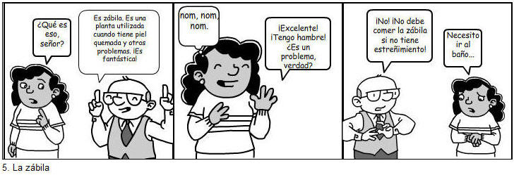
Folk Medicine Wiki Project
Makebeliefscomix.com
Student Comment: “I was a little worried at first when I realized that we had to create this comic strip. I wasn't sure what the program was going to be like, or how I would intertwine folk-medicine. However, the program was surprisingly easy, and fun! It was quite entertaining to look through the characters and see things like the alien, the alligator, the frog..and the list goes on. It was an interesting way to allow us to express ourselves while showing what we're learning/have learned at the same time. Everybody did a great job! ”
Article: The Student Built Botanica

Slide 19
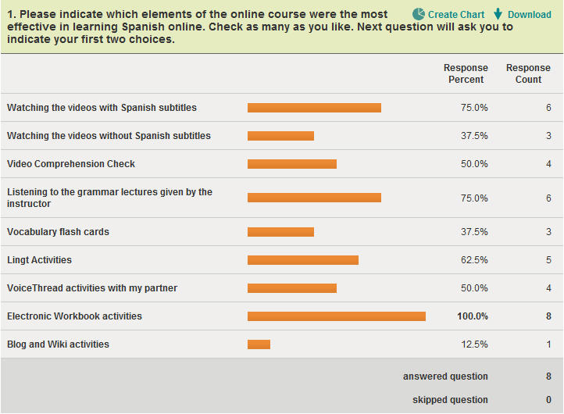
Student Feedback-Activities

Slide 20
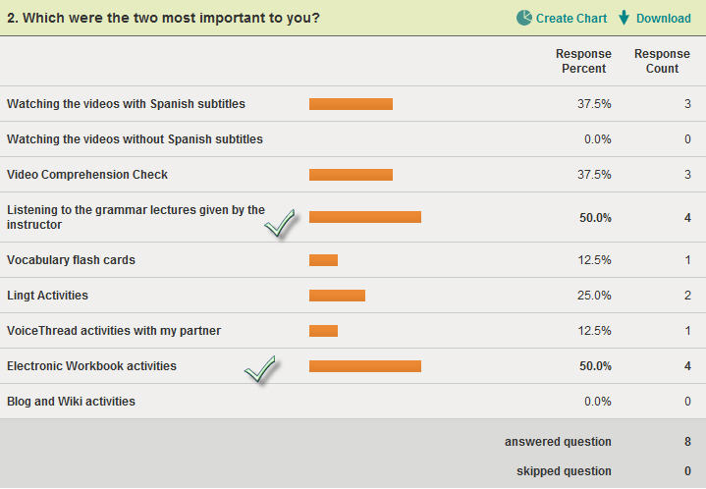
Student Feedback

Slide 21
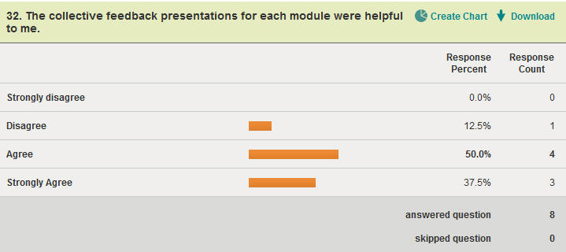
Student Feedback-Collective Feedback from Instructor

Slide 22
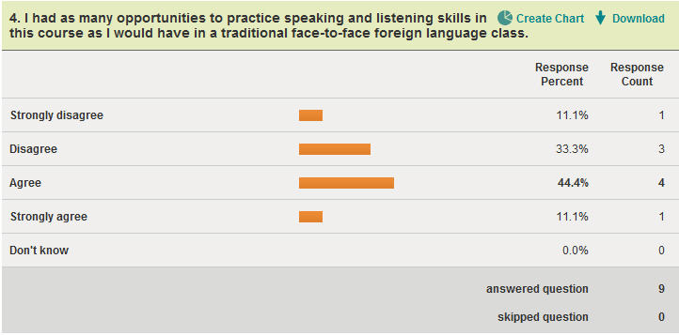
Speaking & Listening?

Slide 23
Liked-
The comprehension workbook and watching the videos originally without the subtitles, then watching them again to learn the grammar. I enjoyed working with my Spanish Partner.
I liked the grammar presentations, as they reinforced the information from the book, especially those that incorporated examples and quizzes within them.
Although I found them very difficult, the Lingt quizzes were helpful; rather, the feedback received was extremely helpful. The comprehension checks and workbook exercises were also beneficial.
A lot of things... the teacher was knowledgeable, kind, and flexible when called for. She was awesome, and knew how to make an online course fun, interesting, and educational. There were a variety of activities so it didn't get boring.
I liked the variety of learning methods - they made learning Spanish very interesting and different.
The grammar presentations were excellent- easy to follow, and covered material that might otherwise be difficult to learn.
I greatly enjoyed this Spanish class online. I think it is important that it only be offered to Juniors/Seniors/Graduate students because younger students may not have the time management skills required to complete an online course. I enjoyed the grammar presentations and practice speaking that was allowed for each week.
It was almost like a set of puzzles or games to complete each week - with the online activities, Lingt, voice threads and flashcards. This course was definitely one of the best classes I have taken. I looked forward to new material, learning new vocab and answering questions presented to me in the Lingt activities. I absolutely loved it. I did find the VT's challenging especially because of translation and pronunciation but it was fun to listen to the completed dialogue!

Slide 24
Liked Least –
I feel not being able to speak the language every day makes it hard to gain confidence in speaking. I feel I can understand the language more from writing it and using the flash cards.
Being required to work with a partner. One of the most appealing characteristics of an online course is that you can do your work on your own timeline. Being forced to work with someone made an already demanding and time intensive course significantly more challenging.
I really did not like the blog that was required - especially when we had to respond to someone else’s blog. It is difficult to think of a response when we are all at such different places in our careers and at such different educational levels.
Group work. It was difficult to try to coordinate my schedule with someone elses to get the assignments complete.
don't know - like it all.
I did not like the weekly partner speaking drills. Once every other week would have been much easier to coordinate. Coordinating was often very difficult and hard to complete assignments as a group. It was also hard to develop a routine because on one week assignments were due a certain set of days and the following week has slightly different days.
It was hard to learn the language on my own since I've never learned any Spanish before.
The partner activities, because my partner was lazy and full of excuses, and often did not tell me things she should have told me.

Slide 25
Challenges
Policy – Cannot require synchronous meetings
Limitations of university-supported technologies
Need to develop grammar resources
Occasional tech support issues with non-university supported tools
General assumptions about online learning
How much can an adjunct achieve as a solo show?
No foreign language TA program
The L1 versus L2 dilemma

Slide 26
Rewards
The online experience can develop important life skills:
technology for academic and professional use
self regulation
collaboration
Student and faculty feedback
Connecting SLA and online learning
Lack of resources forces us to think outside the box
Contribution to culturally competent health care

Slide 27
Rewards
Student: ”It felt absolutely incredible to be able to incorporate my language class into providing holistically competent care with HR and his parents. I had to say más despacio por favor many times and ¿por favor, repita de nuevo para mí? during the interview with his parents but I was proud of myself for being able to communicate and understand HR’s needs as my patient. When I was not familiar with the Spanish word for something in English I would just simply say ¿Cómo se dice en esto español? and HR and his family were overly happy to help me learn the word in Spanish. I would highly recommend a medical Spanish class for all nurses, doctors, hospital staff and medical technicians because it is a course customized for us as healthcare advocates in mind. This medical Spanish class aids anyone in healthcare in communicating with Spanish-speaking patients, their family members and concerned friends. The Spanish language helped me unlock a door of friendliness and respect towards my patients and their families.”

Slide 28
Contact Information
Jennifer Rafferty, MA, M.Ed.
Jennifer.rafferty@quinnipiac.edu
Twitter: @palomitica29, @digitalpedagog
Skype: palomitica29

